Slide 1

Adaptive Learning For Web Recommendation

Slide 2
ADAPTIVE LEARNING METHOD FOR WEB RECOMMENDATION
Batch Members:
Name of the Supervisor:
Dr. J. Benadict Raja
1. Gokul Sri Ram S
2. Narash Kumar A
3. Edwin Rajan G
4. Bala Vignesh K G

Slide 3

abstract
Web Usage Mining plays an important role in recommender systems and web personalization​
In this work, It is proposed an effective recommender system based on ontology and Web Usage Mining.​
The first step of the approach is extracting features from web documents and constructing relevant concepts.​
The pages of the digital learning materials that are estimated to be insufficiently understood by each learner and the web pages related to those pages are recommended.

Slide 4
Problem statement
Create a web recommendation system that suggests personalized and helpful content to users, making their browsing experience better, helping them discover new content, and keeping them engaged.
This system should solve problems like understanding user preferences, understanding web content, choosing the right recommendation method, handling new users and limited data, generating recommendations quickly, and protecting user privacy.
By addressing these challenges, This system aims to provide users with valuable recommendations at the right time, improving their satisfaction and enjoyment while using web applications and services.

Slide 5
Merits
Integrating domain knowledge with Web usage knowledge enhances the performance of recommender systems using ontology-based Web mining techniques. The construction of this model is semi-automated so that the development efforts from developers can be reduced.
The user-profile learning algorithm, responsible for expanding and maintaining up-to-date the long-term user’s interests, employs a domain-based inference method in combination with other relevance feedback methods to populate more quickly the user profile and therefore reduce the typical cold-start problem.

Slide 6

Literature survey

Slide 7
S.no | Title | Description | Merits | Demerits
[1] | Developing an early-warning system for spotting at-risk students by using e-book interaction logs. | In this study, they investigated developing an early prediction system in the context of eBook-based teaching-learning and used students’ eBook reading data to develop an early warning system for students at-risk of academic failure -students whose academic performance is low. | Paper books Means Less putting strain on eyes | Not as Reader-friendly as e-books depending on your needs
[2] | An e-learning recommendation approach based on the self-organization of learning resource | The proposed approach works as follows: firstly, LOs are simulated as intelligent entities using the self-organization theory. LOs can receive information, transmit information, as well as move. Secondly, an environment perception module is designed. | The Implementation of e-learning in education has been favorable in multiple contexts | Despite of the significant advantages of e-learning,students encounter several challenges which ultimately lead towards either limited or negative outcomes.

Slide 8
Demerits of existing system
Existing recommendation systems are: cold-start, sparsely, overspecialization and domain-dependency.
The performance of existing system depends on the sizes of training datasets. The bigger the training dataset size is, predicted pages are limited within the discovered Web access sequences.
The domain ontology can be constructed manually by experts, or by automatically learning models is need to design and implement the learning models which can only be done by professionals at the beginning.

Slide 9
Features of proposed system
In this proposed system that makes use of representations of items and user-profiles based on ontologies in order to provide semantic applications with personalized services.
Proposed recommender system based on ontology and Web Usage Mining. The first step of the approach is extracting features from web documents and constructing relevant concepts. Then build ontology for the web site use the concepts and significant terms extracted from documents. According to the semantic similarity of web documents to cluster them into different semantic themes, the different themes imply different preferences.

Slide 10
Hardware SYSTEM CONFIGURATION
Processor: Intel Processor
Ram: 4 gigabytes
Hard Disk Space: 8 gigabytes

Slide 11
Software SYSTEM CONFIGURATION
Operating system: Windows 10
Coding Language: JAVA for backend, JSP for frontend
Database: MySQL
Browser: Firefox Chrome

Slide 12

System architecture (Hld)

Slide 13
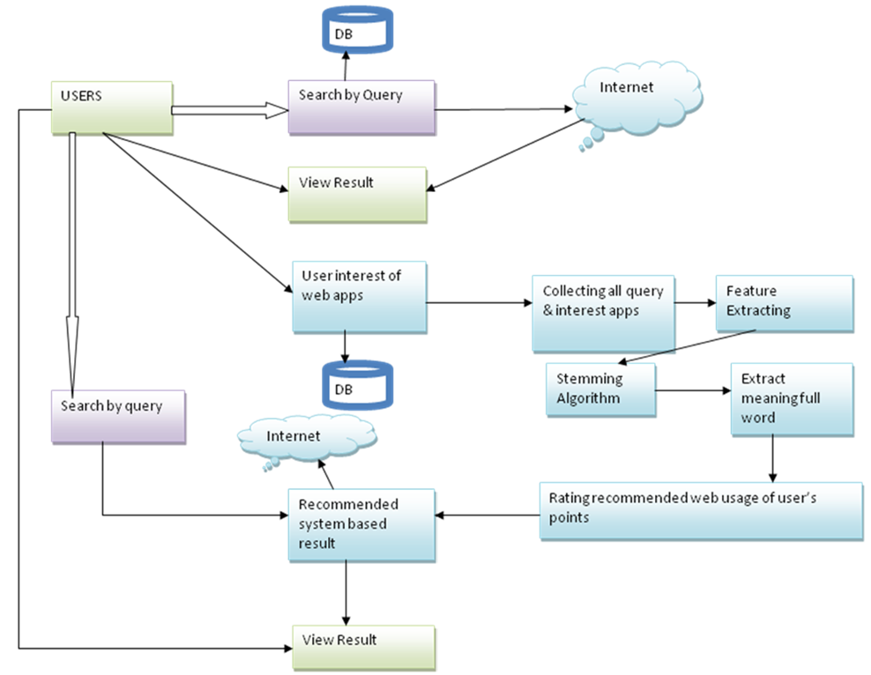

Slide 14
MODULEs
Creating Search history
Query clustering
Query reformulation
History grouping

Slide 15

Creating Search History
The data source for creating user profiles can include personal documents such as browsing history and emails stored on a user's computer
This module enables search engines to gain a deeper understanding of a user's session and potentially customize their search experience based on their specific needs
The clustering process involves identifying the most similar pair of concept nodes, merging the most similar pair of query nodes, and continuing the process iteratively

Slide 16

Query clustering
Concept-based user profiles are employed in the clustering process to achieve personalization effect​
The most similar pair of concept nodes, and then, merge the most similar pair of query nodes, and so on​
we perform the grouping in a similar dynamic fashion, whereby we first place the current query and clicks into a query group

Slide 17

Query Reformulation
For effective grouping of queries and clicks, it is crucial to establish appropriate relevance between query groups
Analysing the search history of numerous users provides signals about query relevance, such as which queries are frequently issued in conjunction with each other
The query reformulation graph and query click graph derived from search logs are instrumental in determining the relevance between queries or query groups in a user's search history

Slide 18

History Grouping
One approach to grouping queries is to initially consider every query in a user's history as a query group, and then merge these groups iteratively using a k-means algorithm
Firstly, it could potentially disrupt a user's existing query groups, thus undoing their manual efforts to organize their search history
Secondly, it involves a high computational cost as a large number of query group similarity computations would need to be repeated for every new query

Slide 19
Test cases
Sl. No | Input | Output | Pass/Fail | Expected Result
1 | Input password validation Must have at least 6 characters | TRUE (0.568) | Passed | True
2 | Login Password Matching | TRUE (0.59) | Passed | True
3 | Search Queries | FALSE (0.30) | Passed | False
4 | Click Through Submit | TRUE (0.583) | Passed | True

Slide 20
Applications
Personalized Search Results: This Proposed system used to provide personalized search results tailored to individual users' preferences, interests, and search history. By analyzing users' past search queries and interactions, the system can offer more relevant and customized search results, improving the overall search experience.
User Feedback and Improvement: This system can collect user feedback on the search results and recommendations they provide. By analyzing user interactions, click-through rates, and satisfaction metrics, search engines can continuously improve their recommendation algorithms and enhance the overall search experience for users.

Slide 21
Future enhancement
User Control and Customization: Future recommendation systems will empower users with greater control and customization options. Users will be able to adjust and fine-tune recommendation algorithms based on their preferences, explicit feedback, and privacy settings. This will allow users to shape their own personalized recommendation experiences.
Privacy and Data Protection: With growing concerns about privacy, future web recommendation systems will prioritize user privacy and data protection. Techniques such as federated learning, differential privacy, and secure computation will be employed to ensure recommendations are made without compromising user privacy.

Slide 22

Output

Slide 23
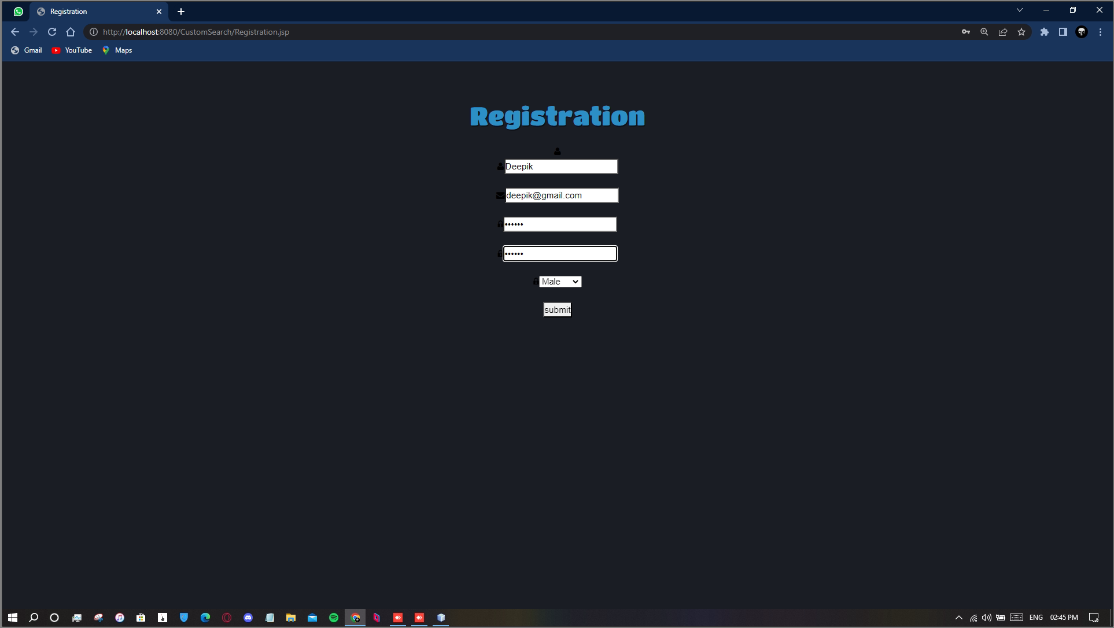
Registration page

Slide 24
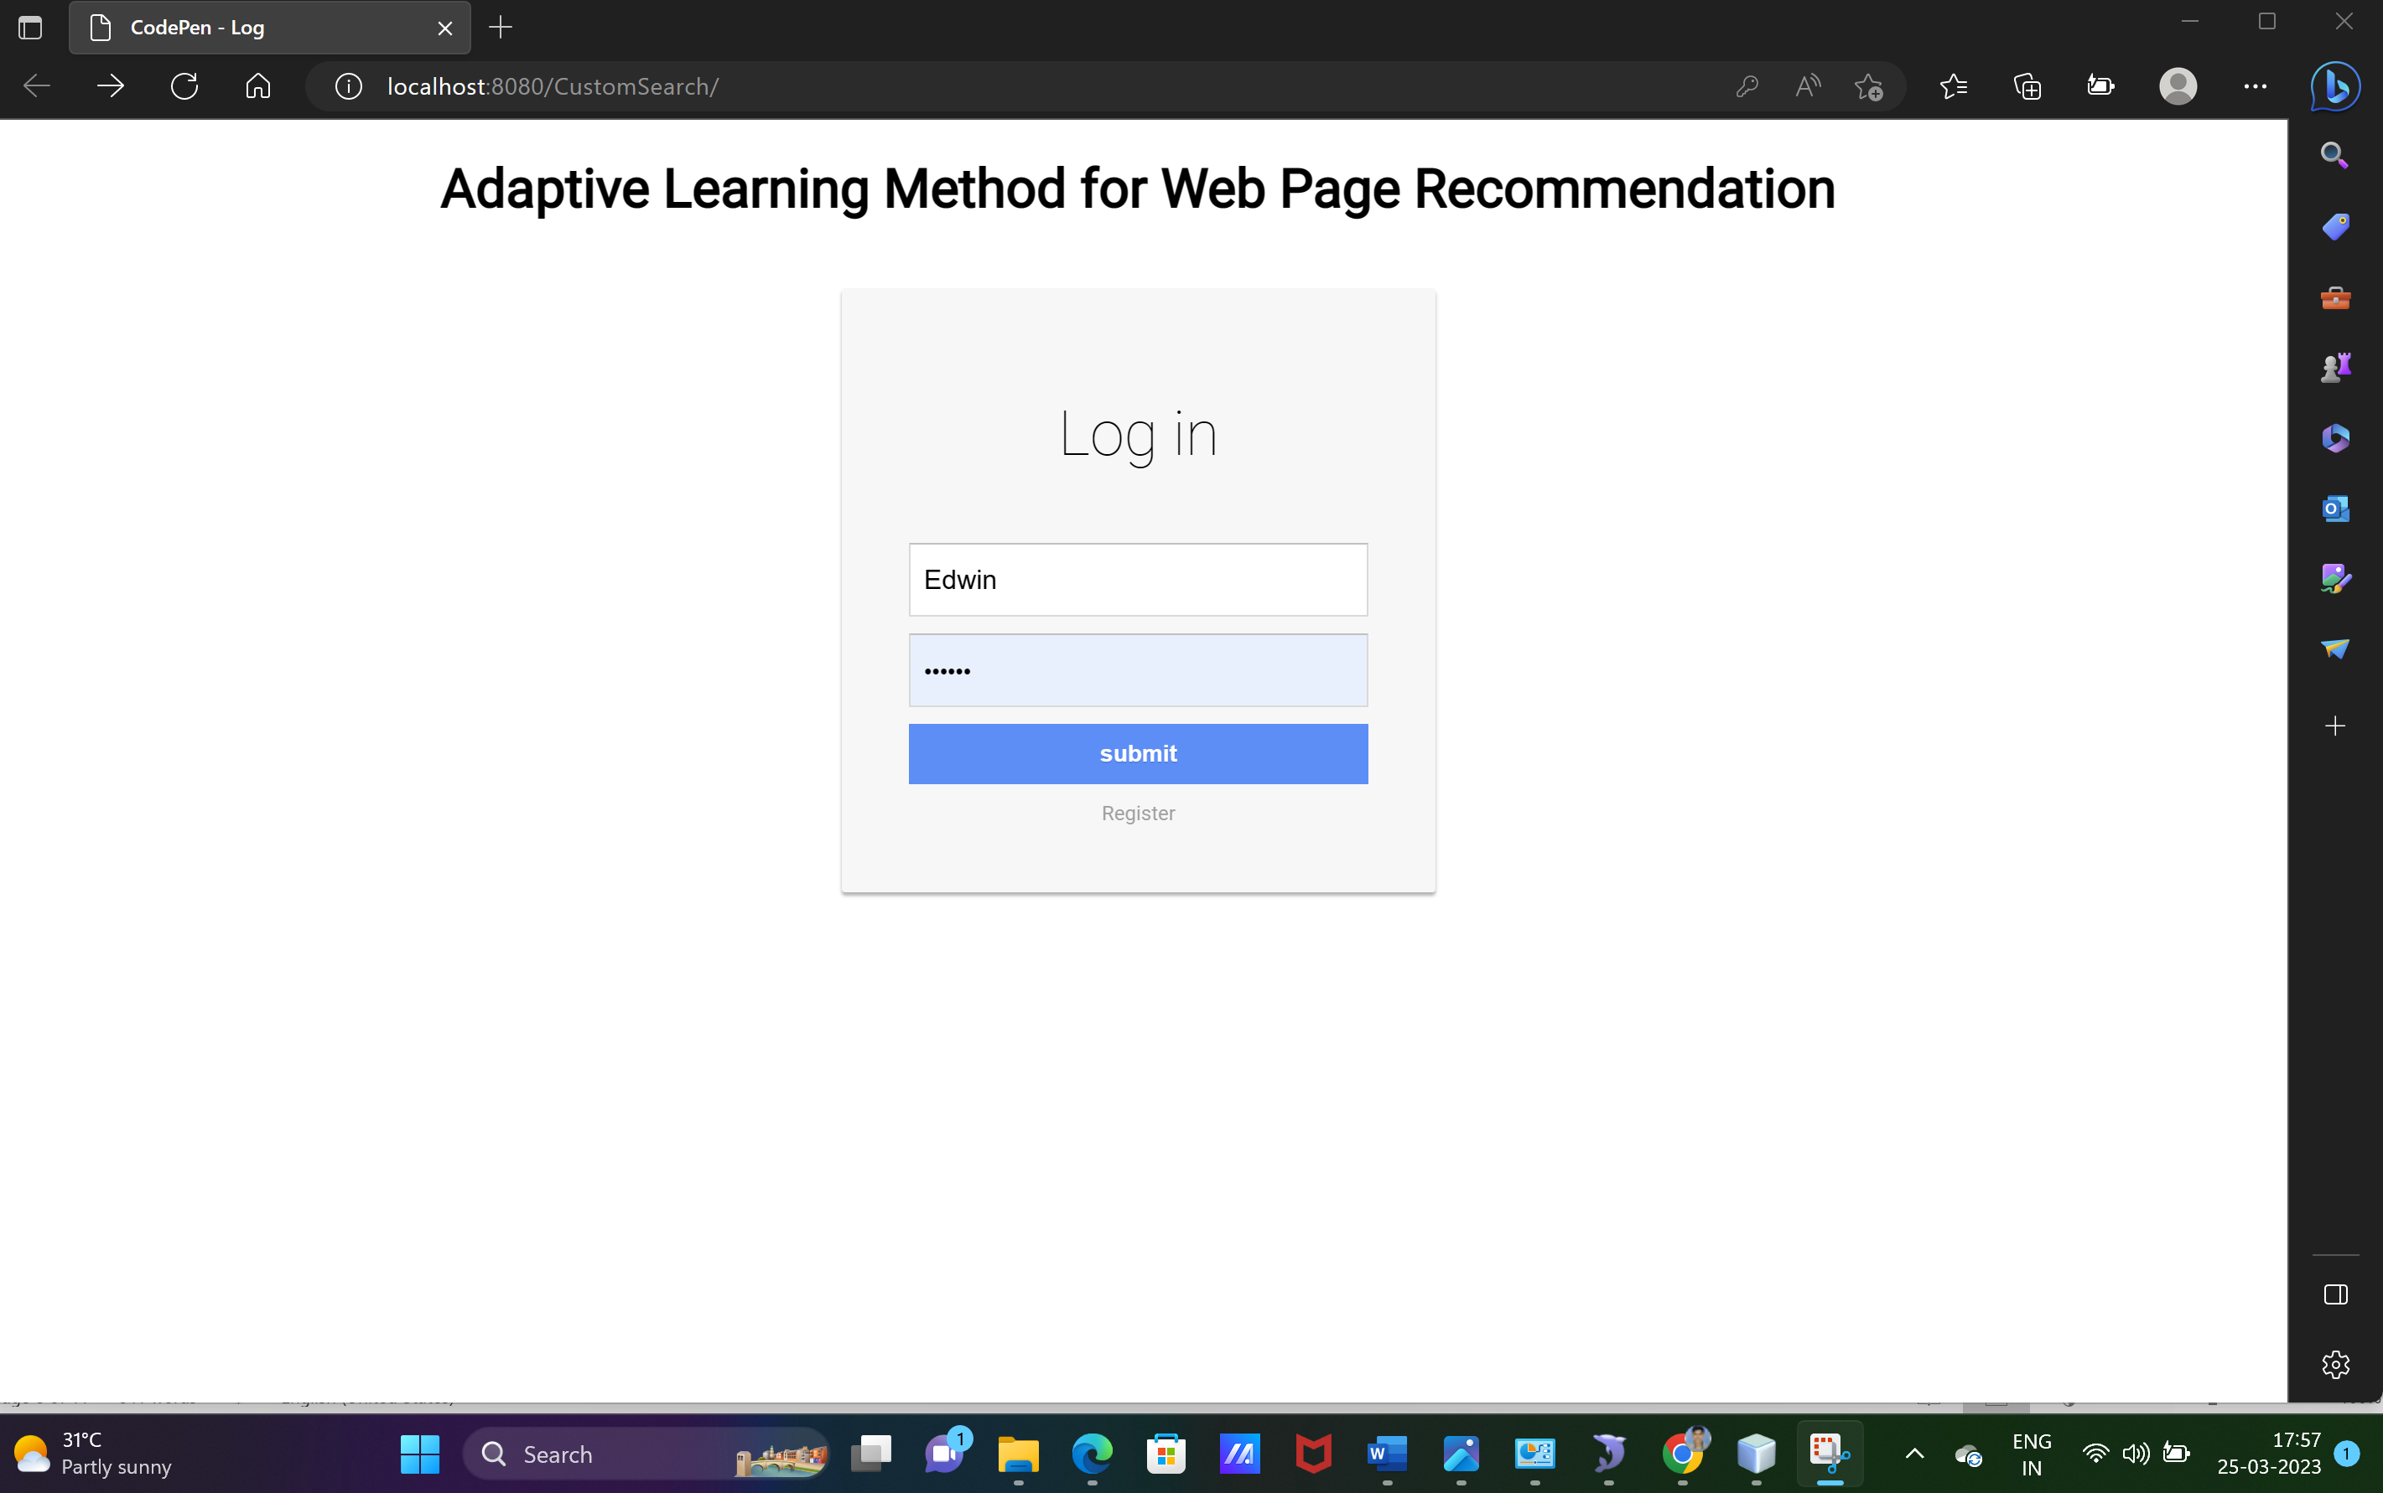
Login page

Slide 25
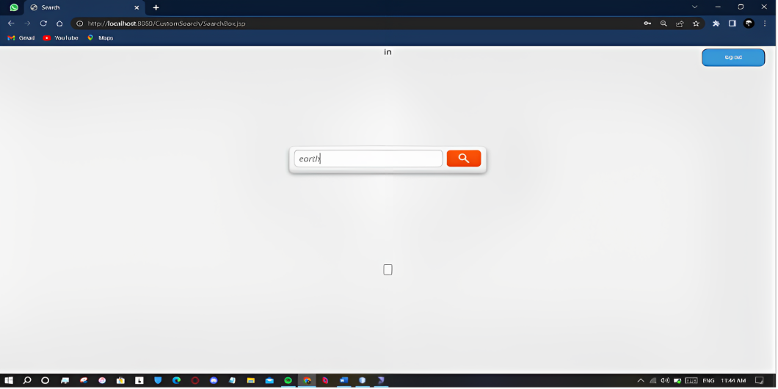
Search page

Slide 26
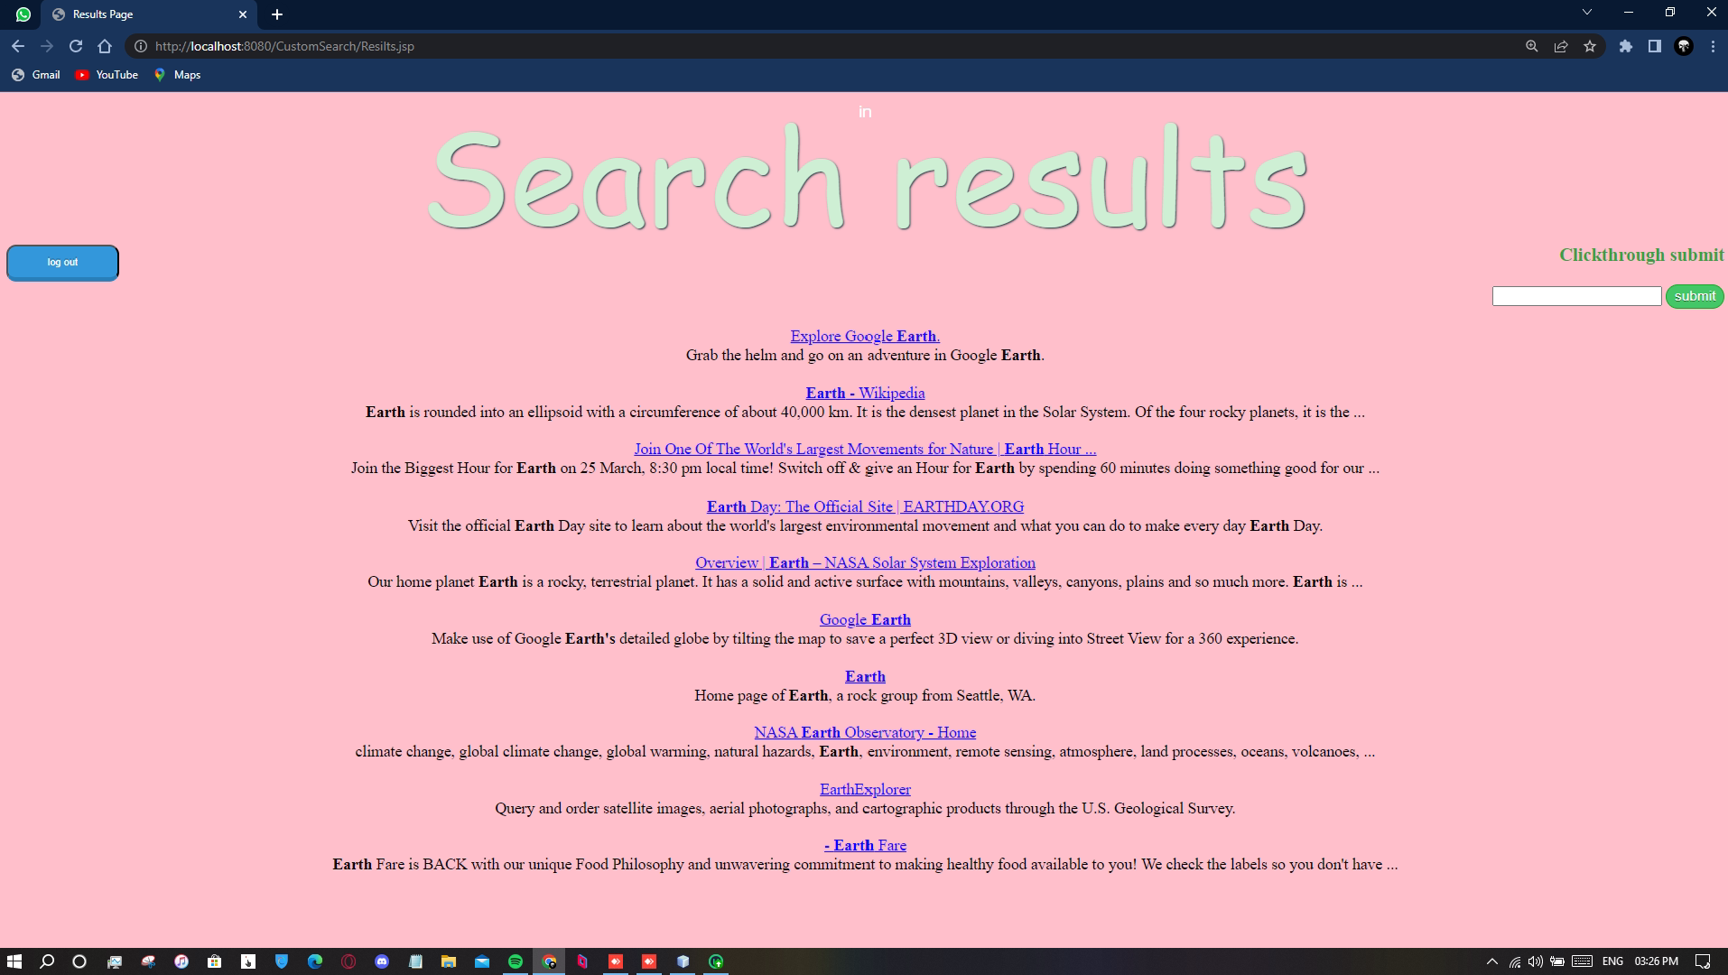
result page

Slide 27
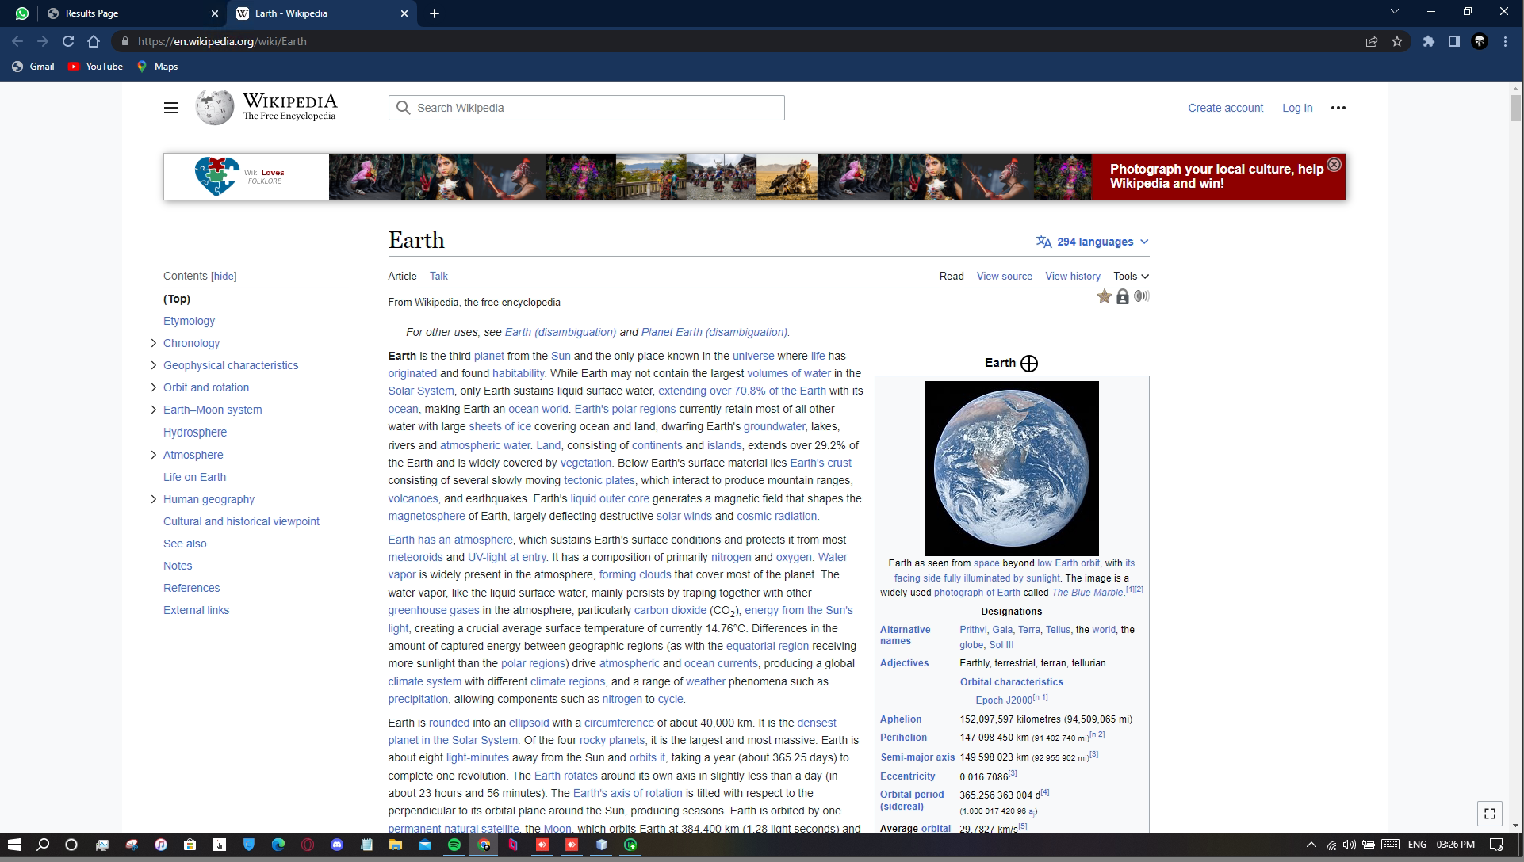
Selected link

Slide 28
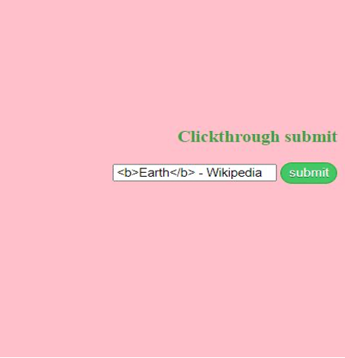
Clickthrough submit

Slide 29

Submitted clickthrough

Slide 30

Recommended search result

Slide 31

CONCLUSION
In this work, a novel approach is proposed to infer user search goals for a query by clustering its feedback sessions represented by pseudo-documents
First, feedback sessions are introduced to be analyzed to infer user search goals rather than search results or clicked URLs
Both the clicked URLs and the unclicked ones before the last click are considered as user implicit feedbacks and taken into account to construct feedback sessions
In reality, this approach can discover user search goals for some popular queries offline at first

Slide 32

REFERENCES
G.-J. Hwang, H.-C. Chu, and C. Yin, “Objectives, methodologies and Research and issues of learning analytics,” 2017.
G. Balakrishnan and D. Coetzee, “Predicting student retention in massive open online courses using hidden Markov models,” Electrical Engineering and Computer Sciences University of California at Berkeley, vol. 53, pp. 57–58, 2013.

Slide 33
REFERENCES
A.Shimada, F. Okubo, and O. Hiroaki, “Browsing-pattern mining from book logs with non-negative matrix factorization,” in Proc. 9th International Conference on Educational Data Mining, 2016, pp. 636– 637.
R. F. Kizilcec, M. Perez-Sanagust ´ ´ın, and J. J. Maldonado, “Self regulated learning strategies predict learner behaviour and goal attainment in massive open online courses,” Computers & Education, vol. 104, pp. 18–33, 2017.

Slide 34
publication
Gokul Sri Ram S, Narash Kumar A, Edwin Rajan G, Bala Vignesh G & Dr. J.Benadict Raja (April 2023). “Adaptive Learning Method For Web Recommendation”. International Research Journal of Modernization in Engineering Technology and Science. (Volume 5 Issue 4, Sr.No:285).
https://www.doi.org/10.56726/IRJMETS35758

Slide 35


